Slide 1


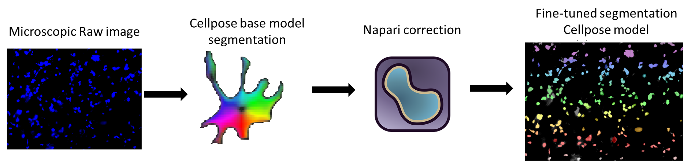
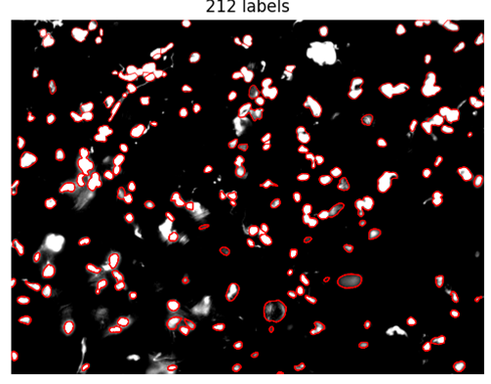
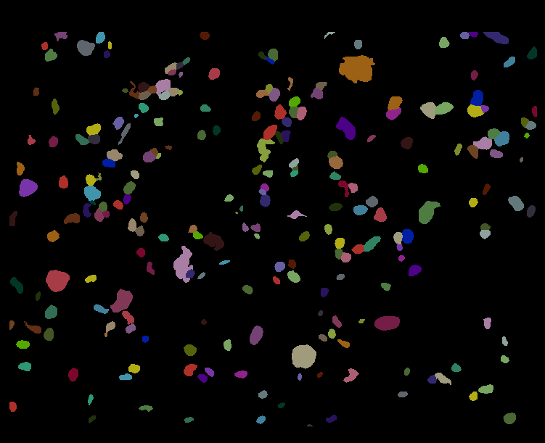
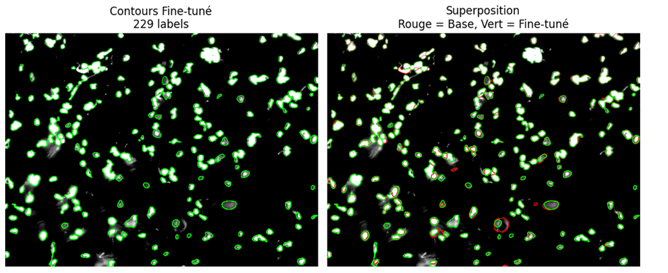
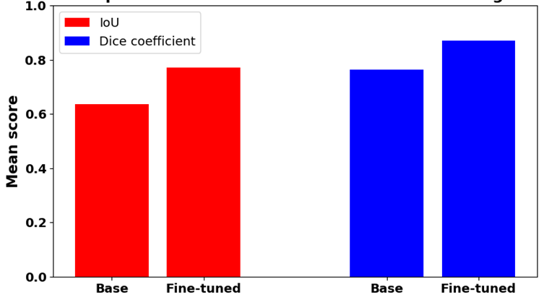
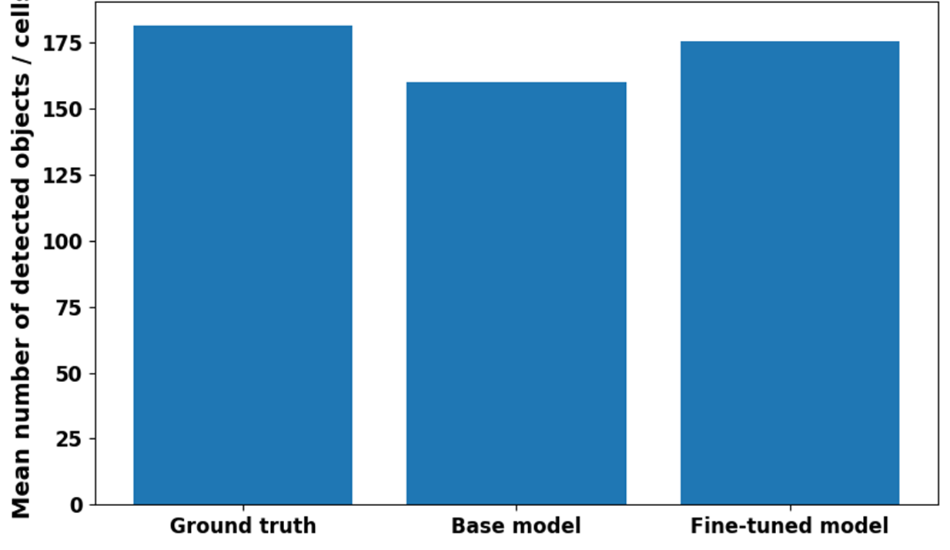
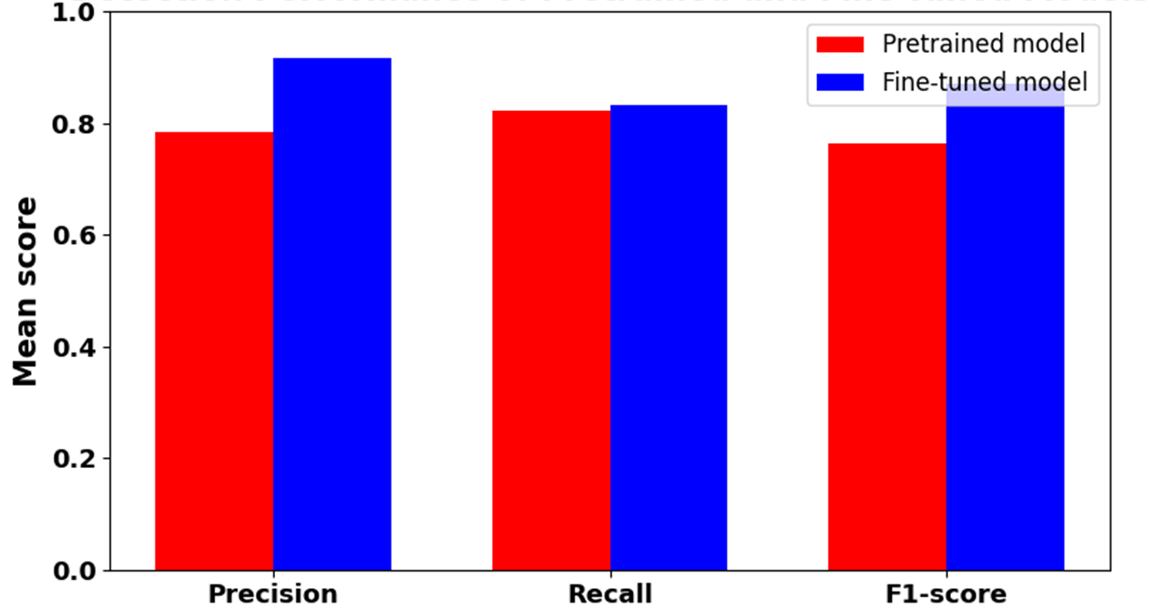
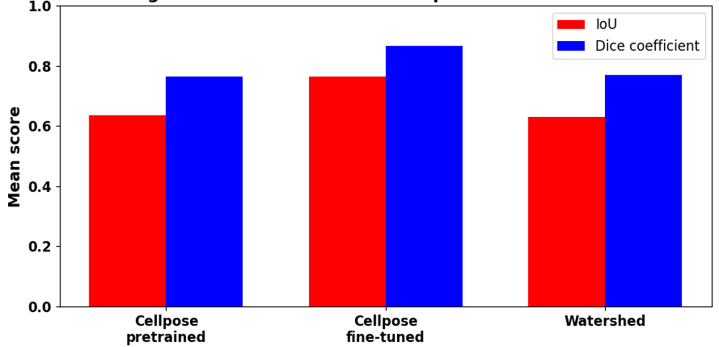
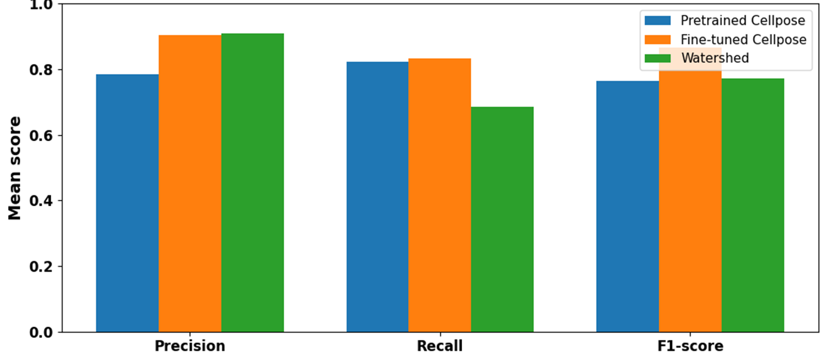
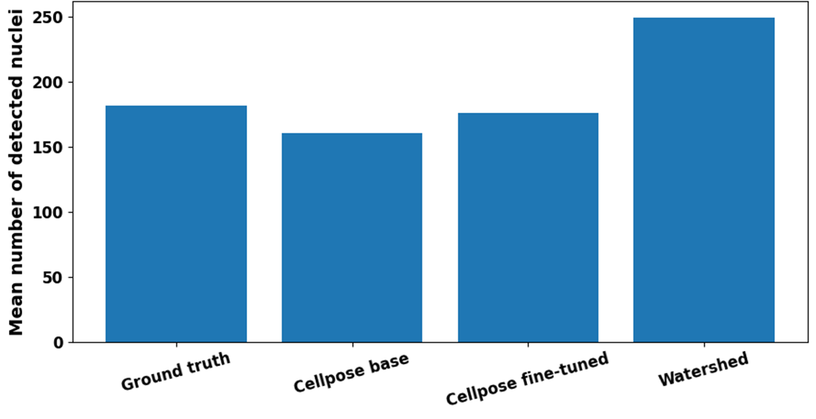

Deep Learning-Based Cell Segmentation for Cellular Analysis
Romain Topalian¹
1: University of Applied Sciences Biberach, Institute of Applied Biotechnology, Hubertus-Liebrecht-Str. 35, 88400 Biberach, Germany; * Presenting author: topalian@hochschule-bc.de
Introduction
Methods
Dataset and computational setup.
The dataset consisted of 16 fluorescence microscopy images of Hoechst-stained cells acquired from tracheal tissue samples. Initial segmentation masks were generated using a pretrained Cellpose model and manually corrected in napari to obtain ground-truth annotations. Fine-tuning was performed with Cellpose v4.0.5 on a GPU-enabled Linux environment using PyTorch 2.10.0+cu128. Model performance was evaluated using IoU, Dice coefficient, precision, recall, F1-score, and cell count comparison.
Cell analysis from fluorescence microscopy images is essential in biological and biomedical research.
Manual image evaluation is often time-consuming, subjective, and difficult to reproduce, especially for large datasets.
This project uses Cellpose to automate cell segmentation and support their quantification
Figure 1: Workflow of the Segmentation and Retraining Process: A pretrained Cellpose model was first applied to fluorescence microscopy images to generate initial segmentation masks. These masks were manually corrected in napari and used as ground truth for supervised fine-tuning, leading to improved cell segmentation on the target dataset.
Results
1. Initial segmentation with pretrained Cellpose
2. Manual correction and generation of ground truth masks
3. Improved segmentation after model retraining
Fine-tuned contours
Overlay
Red= Base, Green = fine-tuned
Figure 2: The pretrained Cellpose model provided a good initial segmentation but showed errors such as missed cells, merged objects, and false detections.
Figure 3: Manual correction in napari produced high-quality ground-truth masks for supervised retraining
Figure 4: The fine-tuned Cellpose model showed better delineation of cells, improved separation of adjacent cells, and fewer false detections.
4. Quantitative evaluation/model performance
Figure 5: Bar plot of IoU and Dice coefficient. Comparison of IoU/Dice coefficient between Pretrained(Base) and Fine-Tuned Models
Figure 6: Number of detected cell count comparison. Comparison of Detected Cell Counts Across Models: Ground truth (Napari), Cellpose base model, Cellpose fine-tuned model
Figure 7: Precision / Recall / F1-score. Detection Performance of Pretrained and Fine-Tuned Models
5. Comparison with Watershed: a classical segmentation method
Figure 8: Comparison of mean IoU and Dice coefficient across all annotated images for the pretrained Cellpose model, the fine-tuned Cellpose model, and the watershed baseline.
Figure 9: Comparison of mean precision, recall, and F1-score across all annotated images for the pretrained Cellpose model, the fine-tuned Cellpose model, and the watershed baseline.
Figure 10: Comparison of the mean number of detected cells across models and the ground truth. The fine-tuned Cellpose model produced counts closer to the annotated reference, whereas the watershed approach overestimated cell numbers.
Conclusion
Outlook
The human-in-the-loop workflow combining Cellpose, napari, and supervised retraining improved the segmentation quality of fluorescence microscopy images.
Manual correction of the initial masks provided high-quality annotations that enabled the development of a dataset-specific segmentation model.
The fine-tuned model achieved more accurate and robust cell detection, supporting more reliable downstream quantitative image analysis.
The customized model can be applied to new microscopy datasets to enable more consistent and automated cell analysis.
Future work will focus on extending the workflow toward cell viability quantification and the analysis of cellular variability across experimental conditions.

